Slide 1
Investor Pitch for EchoSphere
Mind meets Technology
Redefining Wearable Tech with the Power of Your Mind

Slide 2

Introduction
EchoSphere is not just another earbud—it’s a revolution in wearable tech. Powered by cutting-edge Brain-Computer Interface (BCI) technology, it allows you to control your audio experience with your mind. With 3D immersive audio, advanced biometric sensors, and a design crafted from eco-friendly materials, EchoSphere redefines how we interact with sound and technology.
Experience the future of audio, wellness, and sustainability with EchoSphere. Let your mind lead the way!
Mission Statement: To create a harmonious blend of technology, sustainability, and human interaction.
Here is the logo of EchoSphere product

Slide 3
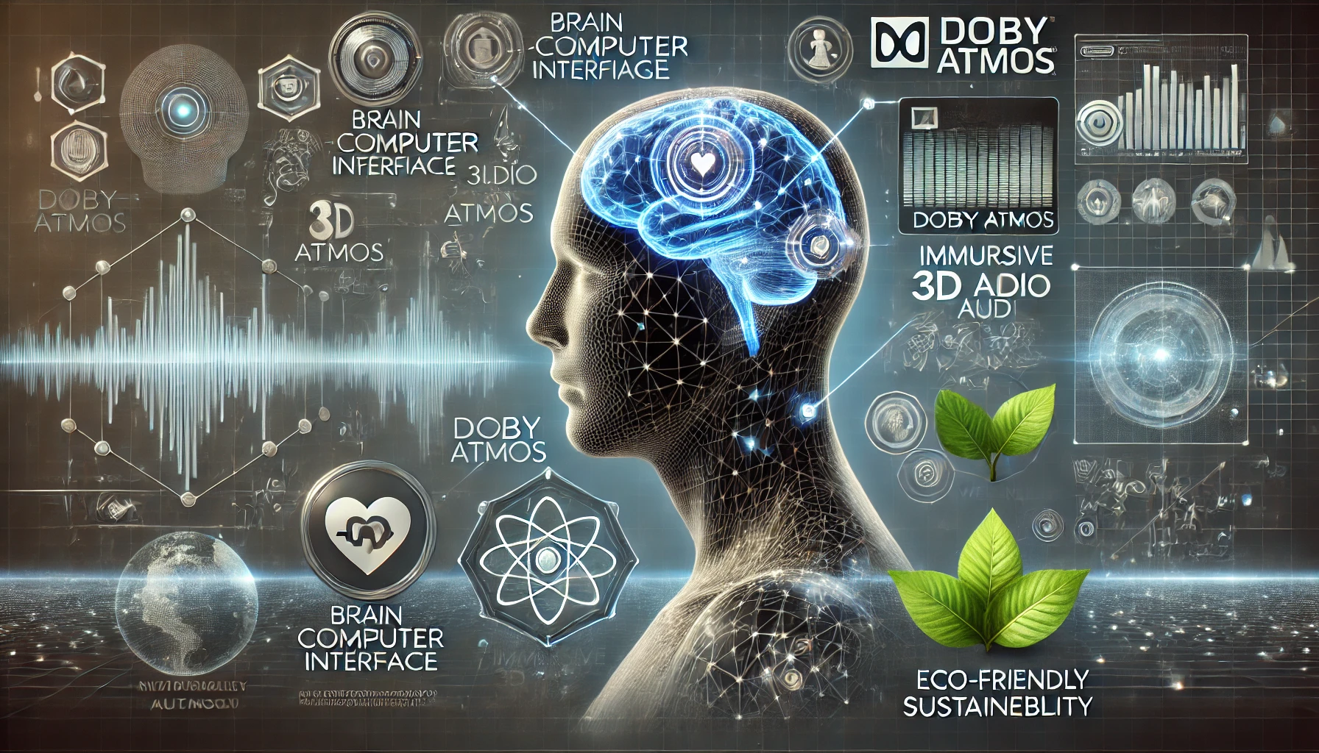
Key Features:
Brain-computer interface (BCI) technology for intuitive control
Immersive 3D audio and Dolby Atmos
Advanced biometric sensors for fitness and wellness tracking
Eco-friendly materials ensuring sustainability

Slide 4

The Problem
Gaps in Current Wearable Tech
Limited Innovation:
Lack of intuitive controls in earbuds.
Poor integration of health and wellness features.
Audio Limitations:
Inadequate immersion and poor sound quality.
Environmental Concerns:
Use of unsustainable materials in tech manufacturing.

Slide 5

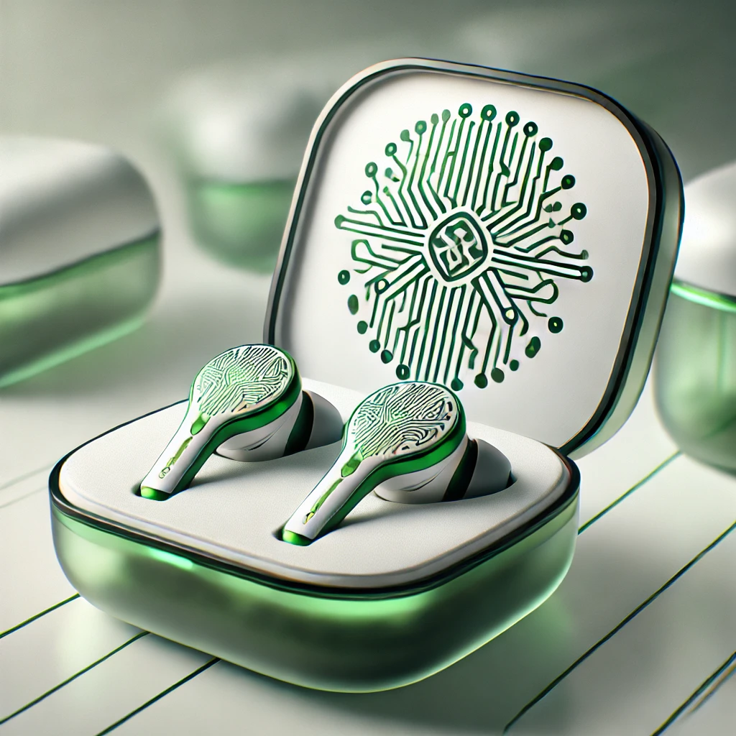
The Solution
Introducing EchoSphere
BCI Technology:
Intuitive controls using brain signals for hands-free operation.
Immersive Audio:
Industry-leading 3D audio and Dolby Atmos support.
Eco-Friendly Materials:
Sustainable, biodegradable design to reduce environmental impact.
Enhanced Wellness:
Real-time health monitoring through biometric sensors.

Slide 6

EchoSphere’s Benefits
Seamless music control without physical touch.
Unmatched audio quality for a superior experience.
Fitness and hearing health insights at your fingertips.
Making sustainable choices without compromising performance.
Personalized sound profiles tailored to your unique hearing preferences.
Choosing EchoSphere means embracing cutting-edge technology, enhancing wellness, and supporting sustainability—all without sacrificing performance or style.

Slide 7
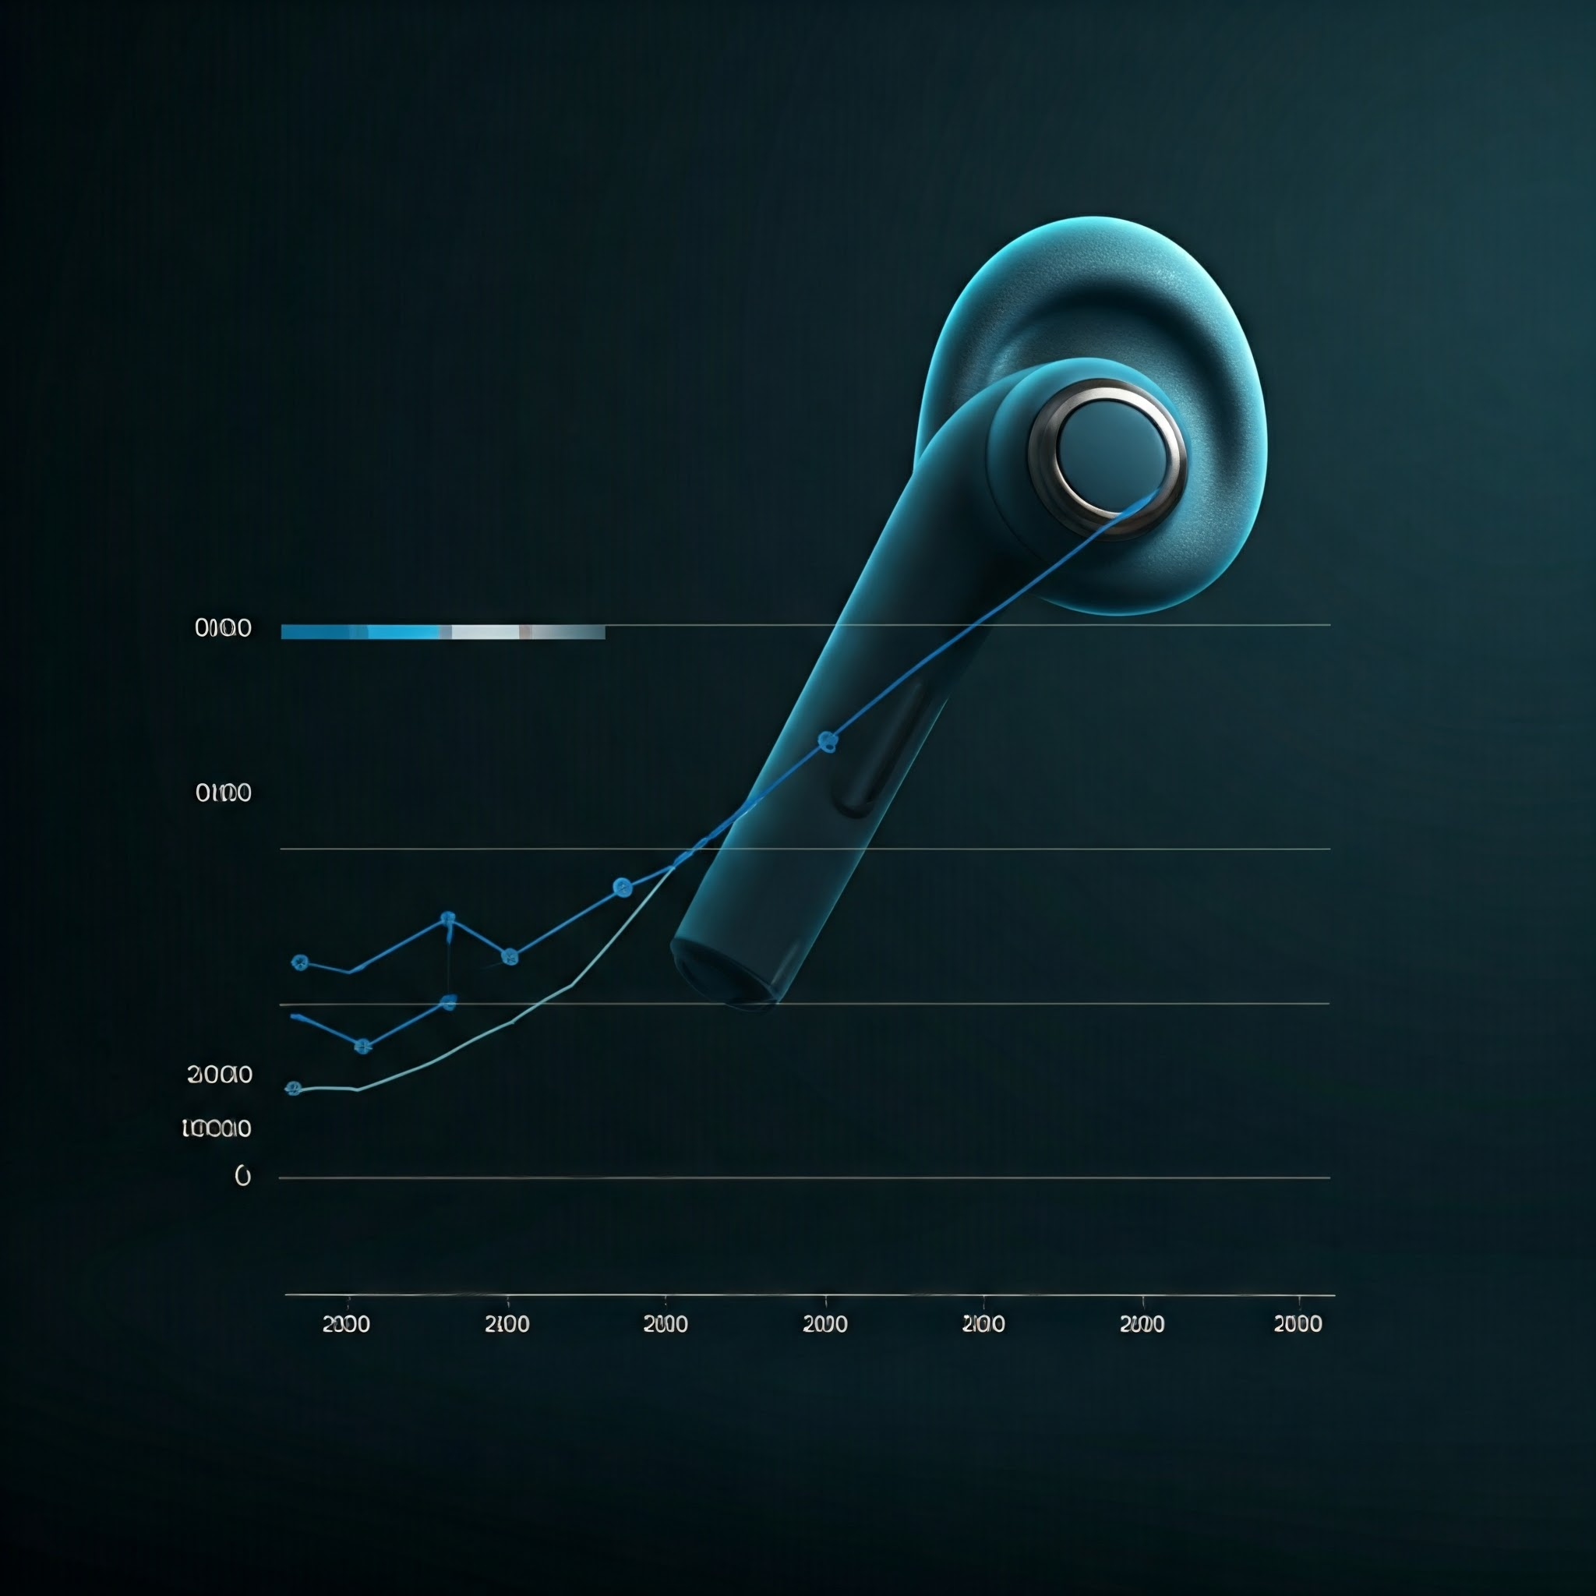
Market Opportunity
Wearable Tech Market Insights
Market Size: $116.2 billion in 2022, expected to grow to $265 billion by 2028 (CAGR: 14%).
Global Earwear Market: Expected to surpass $30 billion by 2028 with a CAGR of 12%.
Target Audience:
Tech-savvy individuals aged 25-45.
Fitness enthusiasts and wellness-focused consumers.
Audiophiles seeking premium sound quality.
Environmentally conscious buyers.

Slide 8
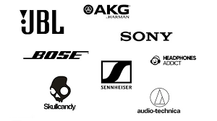



Competitive Analysis
There are Oceans of Competitors for us
Current Competitors: Apple, Boult, Sony, Boat ...
Market Gap: Lack of BCI-enabled wearable tech.
EchoSphere’s Edge: Combines innovation, wellness, and sustainability.
EchoSphere

Slide 9
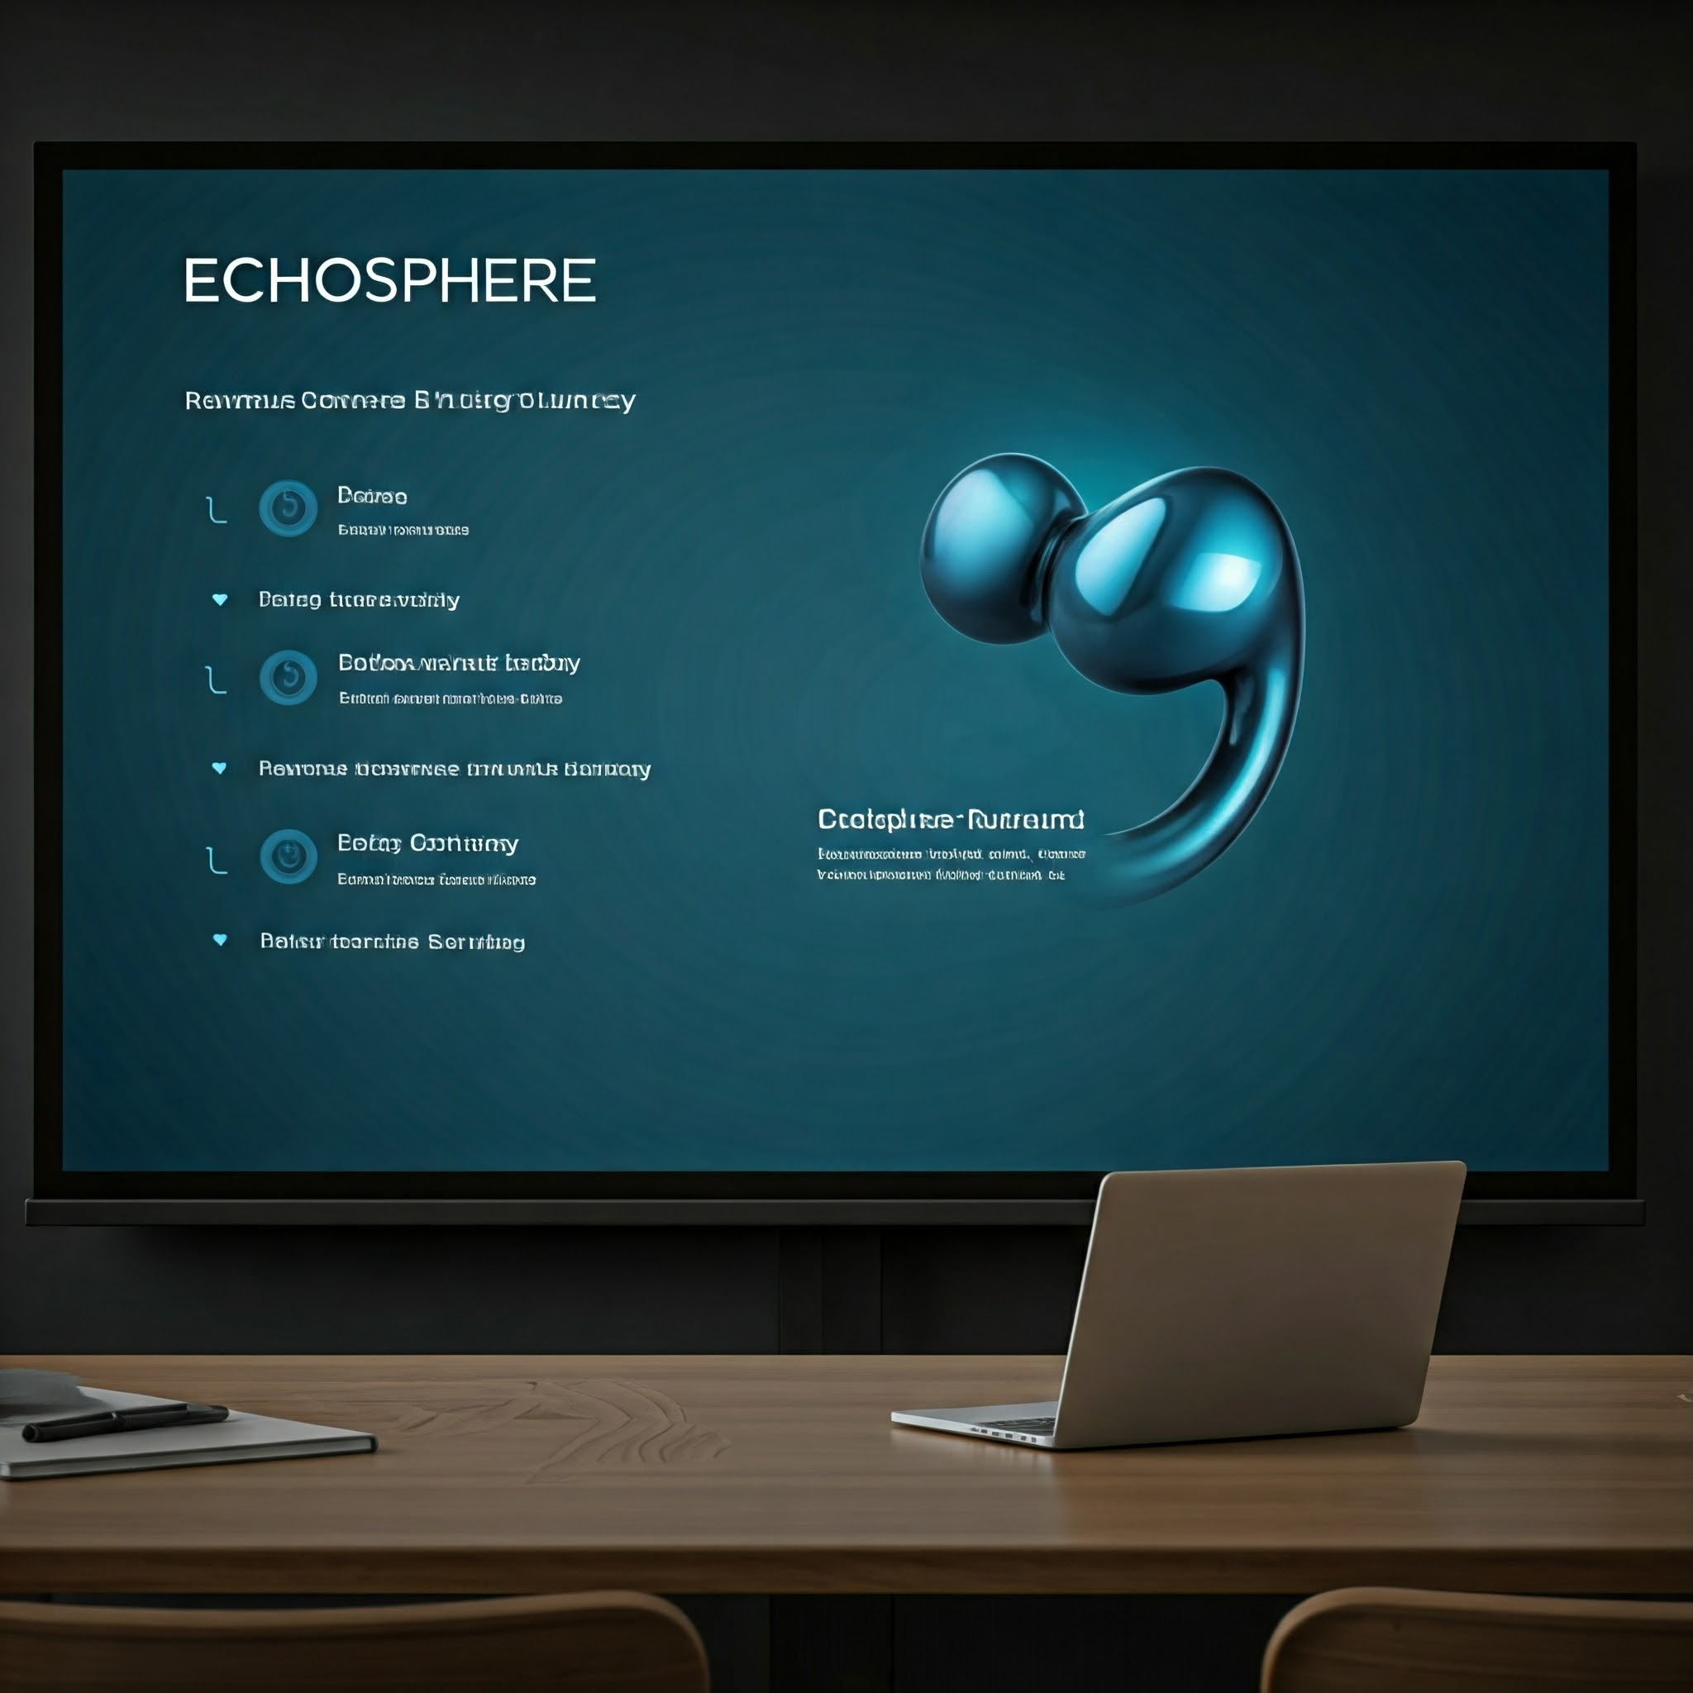
Business Model
Revenue Streams
Primary:
Direct-to-consumer product sales.
Secondary:
Subscription for advanced AI features (e.g., personalized audio profiles).
Pricing Strategy
Product Pricing: Premium tier starting at $99.
Profit Margins: Estimated 60% gross margin.

Slide 10

Marketing and Growth Strategy
Marketing Channels
Social Media:
Campaigns on Instagram, YouTube, and TikTok.
Influencer Collaborations:
Partnerships with tech and fitness influencers.
Content Marketing:
Educational blogs, podcasts, and YouTube videos.
User Acquisition Strategies
Pre-launch hype through teaser campaigns.
Launch offers: 20% discount for early adopters.
Loyalty programs for repeat customers.

Slide 11

Financial Projections
Expected Revenue and Profit Growth (3-5 Years)
Year 1: Revenue: $1M, Profit: $0.4M.
Year 3: Revenue: $5M, Profit: $1.5M.
Year 5: Revenue: $10M, Profit: $5M.
Funding Requirements
Total Ask: $5M.
Allocation:
40% for R&D.
30% for marketing and growth.
20% for production scaling.
10% for team expansion.

Slide 12

The Team
Meet the Visionaries
Founders:
CEO: Expert in wearable tech innovation.
CTO: AI and BCI specialist with 10 years’ experience.
Key Roles:
Head of Marketing: Experienced in global brand launches.
Product Design Lead: Award-winning designer in eco-friendly tech.
We must add a credit to product building engineers.

Slide 13

Why Invest in EchoSphere?
Compelling Reasons
First-mover advantage with BCI technology.
Immense market growth potential.
A strong, experienced team driving innovation.
Commitment to sustainability and wellness.
Long-Lasting & Customizable: With a durable design and long-lasting battery, EchoSphere ensures longevity, while its modular design offers customization and repairability.
Health & Fitness: Biometric sensors track fitness and hearing health, offering a dual-purpose device that appeals to both tech and health-conscious consumers.
Innovative Technology: With Brain-Computer Interface (BCI) and EEG sensors, EchoSphere allows users to control their audio experience using their mind, setting it apart in the wearable tech market.

Slide 14
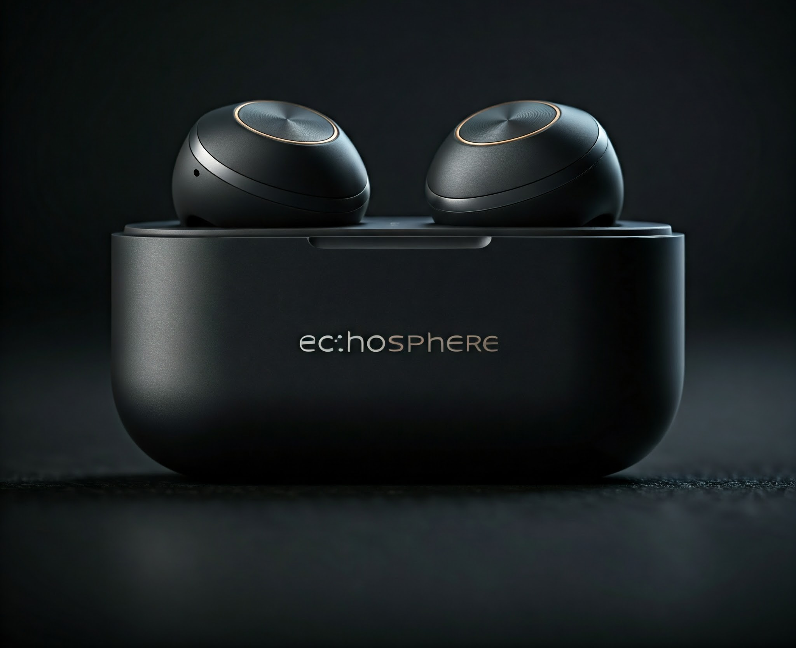
Q&A with Closing Remarks
Let’s create the future together with EchoSphere.
Contact info: +919618130344
Email: echosphere@support

Slide 15
Thanks for your time and interest

